Slide 1
SimTIE: A simulation game on technology integration in education
Presentation by Rod Myers
IST Conference 2008
Indiana University

Slide 2
Caveat
“Writing about music is like dancing about architecture.”
Elvis Costello
Talking about games is like …
Notes:
To understand music you have to hear it, and to understand a game you have to play it. Hopefully you’ll get a sense of what SimTIE is like, but more importantly you’ll understand the design problems we faced and see how we attempted to solve them.

Slide 3
Project Context
R641, Spring 2007: Dr. Frick
Authentic design problem with the client being Dr. Frick’s SimEd research group
Formulate a design concept, design and develop at least two paper prototypes, and playtest those prototypes as part of formative evaluation to guide further development
Design Team
Ji Young Chong, Lin Tian, Terry Miles, Rod Myers, Peng Wang, Sean York; Assistant Instructor: Dr. Jaesoon An

Slide 4
Design Problem
Design a prototype simulation game that allows preservice teachers to practice integrating technology into their instruction.
Learning Goals
Understand systems concepts and apply systems thinking to the problem of technology integration into education.
Given an existing education system, make changes in that system over time that lead to effective technology integration in that particular system.
Notes:
The simulation game was not supposed to teach systems concepts and systems thinking explicitly; instead they were to be inferred by the player based on the results of her decisions.

Slide 5
Teacher Education
Schrader, Zheng, and Young. (2006). Teachers' perceptions of video games: MMOGs and the future of preservice teacher education. Innovate 2(3).
Survey of 203 preservice teachers in 3 universities
60 males, 138 females, 5 no report
Majority (76.4%) had played video games
Over 80% of those played weekly
“…the data does indicate that preservice teachers are open to new applications of technology and in fact consider games to be important educational tools” (p. 4).

Slide 6
Teacher Education
Prominent simulations in teacher education
The aha! Classroom Sim: Classroom discipline skills
The Cook School District simulation: Prepare for evidence-based assessment of teaching following the Teacher Work Sample Methodology
SimClass: Classroom motivational skills
SimSchool: Adapt instruction to individual learners’ needs and preferences
SimTIE: Technology integration in teaching practice

Slide 7
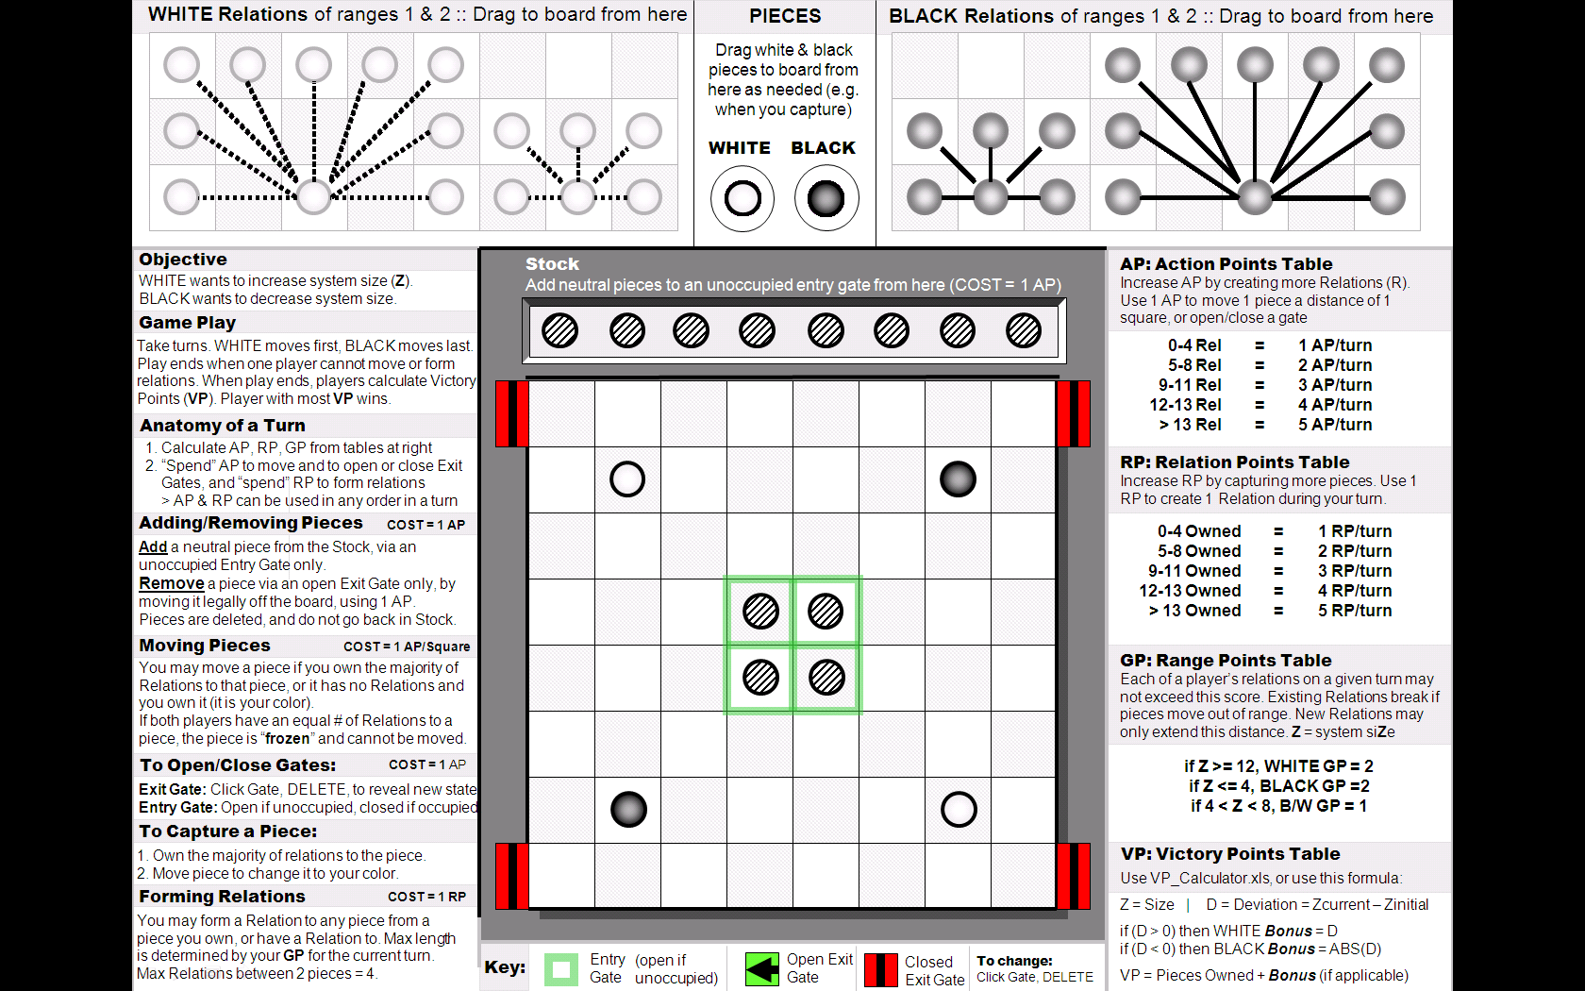
“Size Game” Prototype
Notes:
Sean was participating in the SimEd research group and had started developing some ideas he had about using games to teach systems concepts.

Slide 8
Design Decisions
Key Attributes and Constraints
Provide a variety of student models
Variables: intelligences, preferences, attitudes, behaviors, backgrounds
Provide a variety of (hard and soft) technologies and resources
Make success contingent upon using appropriate technologies to affect student engagement and achievement
Vision
Players match virtual students (with a variety of backgrounds, aptitudes, and preferences) with learning activities that utilize particular strategies and methods, address specific skills and competencies, and require certain resources.
Notes:
The design team created a list of desired attributes and design constraints for the game. This enabled us to understand the design space in which we would brainstorm concepts and scenarios and kept us from deviating too far from the client’s vision and needs.

Slide 9


Design Decisions
Framework
Original concept: hub-and-spoke with SimTIE as centerpiece surrounded by smaller supporting games
Revised concept: spiral based on Elaboration Theory
Begin with the simplest version
of the whole game (the epitome)
with few students and options
and then progress to increasingly
complex versions with more
students and options.
Notes:
We also envision a larger spiral for a series of simulation games that broaden in focus from student to classroom (SimTIE) to school to school district.

Slide 10
Design Decisions
No particular grade level | 4th-6th grade
Core skills: Reading Comprehension Writing Skills Math/Science Reasoning Elective skills: Problem Solving Interpersonal Skills Technology Skills Tactile/Kinesthetic Skills Naturalist Skills Leadership Skills. | Math standards: Number Sense Computation Algebra and Functions Geometry Measurement Problem Solving Data Analysis and Probability Other modules can be developed for different grade levels and subject areas.
Notes:
The original goal was to facilitate virtual students’ proficiency in core/elective competencies. Practical considerations (i.e. chance of obtaining development funding) guided decision to focus on STEM standards.

Slide 11
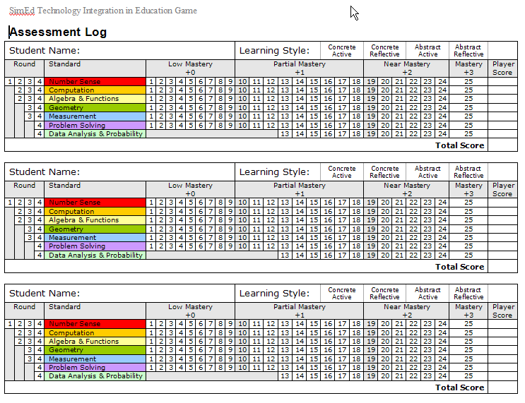
Design Decisions
Learning achievement scoring
Notes:
At the back of the handout is a comparison of this Assessment Log with an early version.

Slide 12
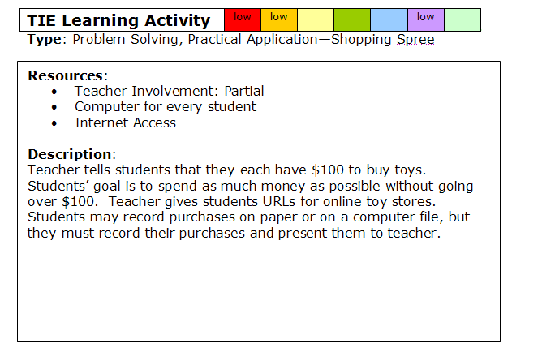
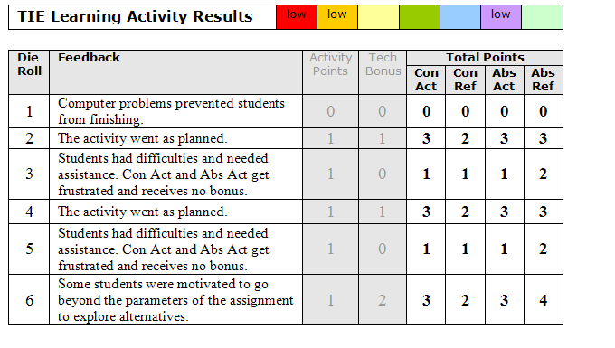
Design Decisions
Central Game Mechanism
Selecting appropriate Learning Activities for students
Standards and mastery levels
Instructional strategies and student preferences
Resources
Front
Back
Notes:
An activity must align with a student’s mastery level(s) for the standard(s) addressed. A student’s learning achievement score is based on the use of appropriate technology and alignment with the student’s learning style.

Slide 13
Design Decisions
Theory-based Student Model
Myers Briggs Type Indicators
Keirsey Temperaments
Hermann Brain Dominance Instrument
Felder-Silverman Learning Styles Model
Gardner’s Multiple Intelligences
Kolb’s Learning Style Inventory
Also consider socio-economic background, strengths and interests, anxieties, friendships, experiences, goals….

Slide 14
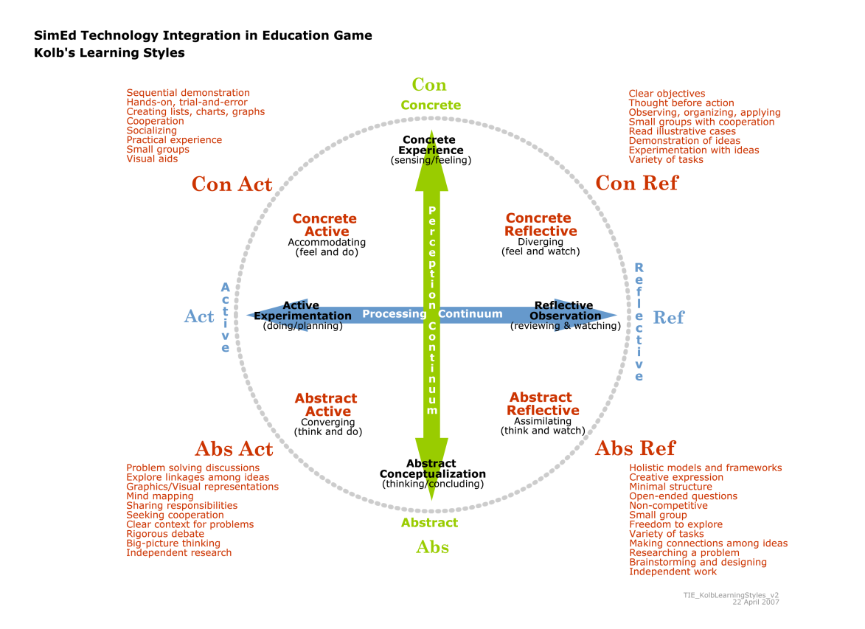
Design Decisions
Theory-based Student Model
Notes:
We selected Kolb’s model because it was the simplest and easiest to implement in a board game. However, the digital version of the game may allow the teacher/player to choose from several models.

Slide 15
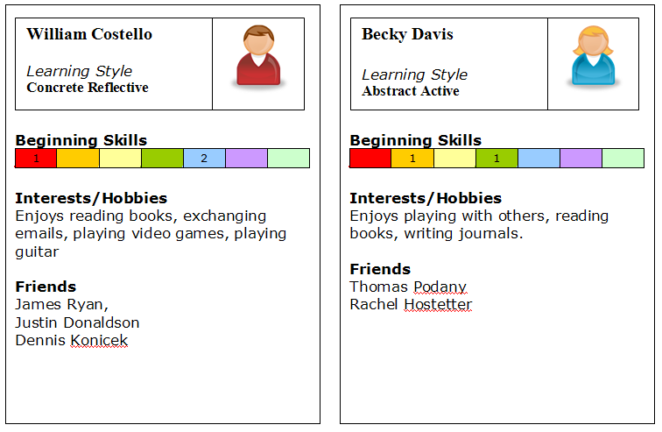
Design Decisions
Student Information Card
Not used in board game but may be incorporated into digital version

Slide 16
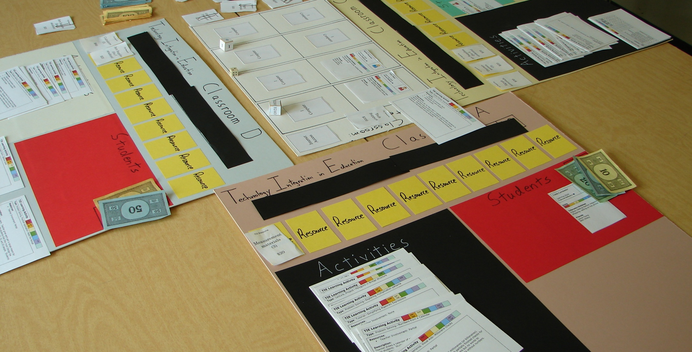
SimTIE board game
Each player (or team) has a classroom. During a turn, the player matches activities with students and ensures that the appropriate resources are available. In the center is a shared computer lab.

Slide 17
Playtesting
Trial Run
Dr. Frick, Dr. Brush, and Dr. Leftwich played with partners from R641 class
Made it through 1 turn and then started brainstorming
Need for more variability of results
1st Playtest
3 students (mmf); 2 Preservice Teaching, 1 graduate student in Math Ed
Team play preferred over individual
More matching than thinking—too much scoring information available when choosing activities: revised Learning Activity cards
2nd Playtest
3 pairs of students (ff, mm, fm); 4 Preservice Teaching, 2 Sports Marketing
Initial perception of complexity allayed after 1 round of play
Learning goal thought to be awareness of learning styles
Need better playtesting protocol

Slide 18
Important Lessons
It’s hard to design a board/digital game concurrently
Different potentials for scope and complexity
Models must be simpler in board games
Calculating results can be time consuming and prone to error
The “Transfer Problem”
Entertainment games aren’t concerned about what they’re teaching the player
To ensure that players are learning the right things, success (i.e. scoring) should be based on appropriate theories
Instructional games should be played within a learning context (e.g. preparation for playing the game, debriefing after the game, reflection on decisions and results)
Learning by Designing
Confronting these design problems has clarified our thinking about modeling education systems

Slide 19
Future Plans
Review literature and explore theories
Find collaborators & content developers, including SMEs in:
Teacher education
STEM education and STEM subject areas
Find funding
Design and development
Usability testing and formative evaluation
Conduct research on effectiveness of SimTIE, write papers, present findings

Slide 20
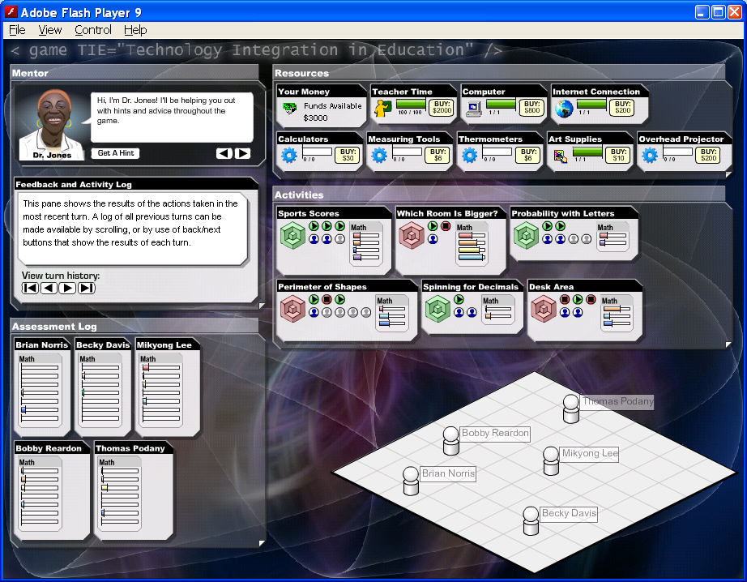
SimTIE Digital Prototype

Slide 21
Questions?
Email: rodmyers@indiana.edu
Email: frick@indiana.edu
http://www.indiana.edu/~tedfrick/researchgroups.pdf
Thank You

